Slide 1
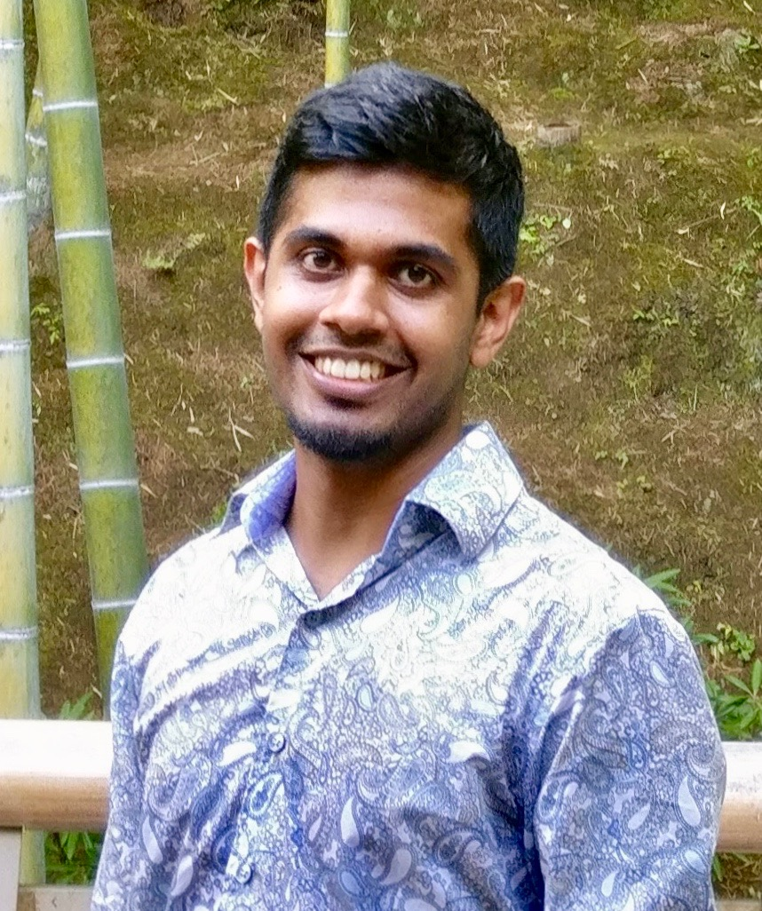
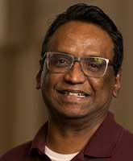
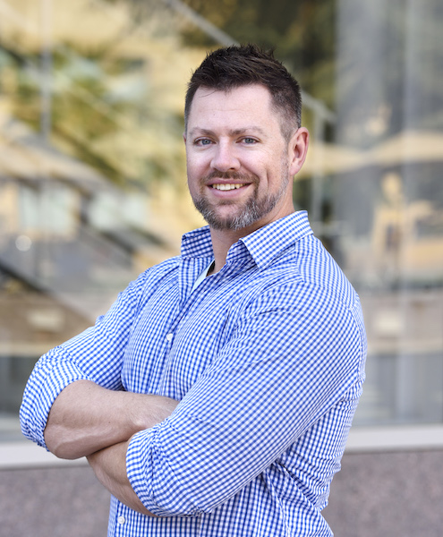
Smart, Responsible, and Upper Caste Only: Understanding Caste Attitudes through Large-Scale Analysis of Matrimonial Profiles
Ashwin
Rajadesingan
Ram
Mahalingam
David
Jurgens

Slide 2
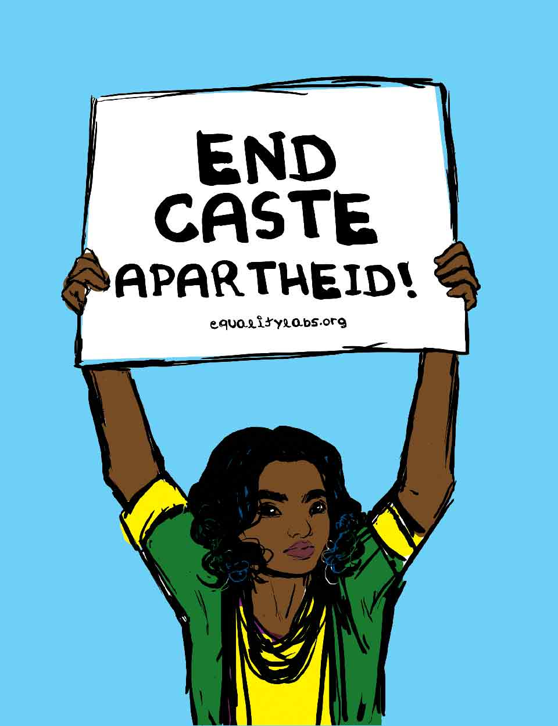
Caste Discrimination
Oppressive social hierarchy
Determined access to public resources, employment, education etc., reducing social and economic mobility
One of the oldest forms of discrimination
Photo Source: Equality Labs

Slide 3
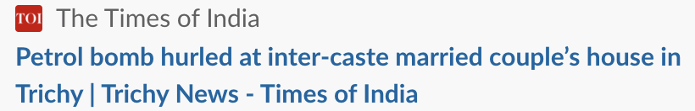
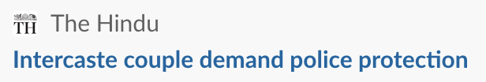
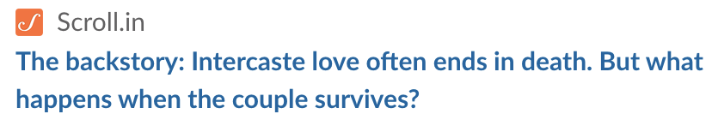
Intra-caste marriage
reproduces caste system
Strong social norms against intercaste marriage
Caste boundaries maintained through violence

Slide 4
Are attitudes towards caste identity changing?
Hard to say! Some survey work has shown change (Dhar 2013, Goli, Singh, and Sekher 2013; Ray, Chaudhuri, and Sahai 2017)
Surveys suffer from social desirability bias (Krumpal 2013)
Audit studies have been tough to scale and account for regional differences (Banerjee et al. 2013; Ahuja and Ostermann 2016)

Slide 5
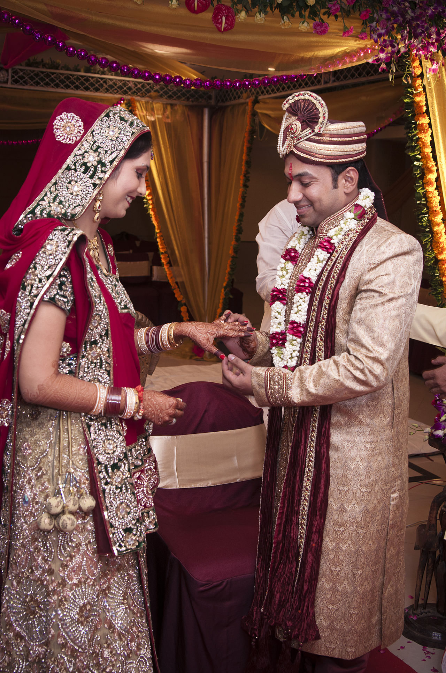
This study: use openness to inter-caste marriage as a proxy for caste attitude
RQ1: Are there differences in openness to intercaste marriage when individuals have more agency in choosing their spouse?
RQ2: If not caste, what attributes do individuals who are open to intercaste marriage prefer in a spouse?
kunjan detroja [CC BY-SA 2.0 (https://creativecommons.org/licenses/by-sa/2.0)]

Slide 6
Analyzing a large dataset of matrimonial profiles
Caste name
Default is not open to intercaste marriage

Slide 7
Shaadi profiles are rich in details
Education
Income

Slide 8
Can describe yourself and who you’re looking for

Slide 9
…and family members can also post for the couple
They can also post their own profiles
Still from movie Dilwale Dulhania Le Jayenge

Slide 10
Ethical considerations
Risk-Benefit Analysis
Public or private data
Contextual expectation of privacy
Data privacy and protection

Slide 11
313K matrimonial profiles
 | Self-posted | Family-posted
Male | 175,611 (56.0%) | 50,245 (16.0%)
Female | 39,039 (12.5%) | 48,413 (15.5%)
Notes:
Male self-posted profiles

Slide 12

Higher-status castes are slightly overrepresented on Shaadi
Caste hierarchy
Percent of profiles by caste group, comparing dataset to IHDS
(Indian Human Development Survey)

Slide 13
Research Questions
RQ1: Are there differences in openness to intercaste marriage when individuals have more agency in choosing their spouse?
RQ2: If not caste, what attributes do individuals who are open to intercaste marriage prefer in a spouse?
kunjan detroja [CC BY-SA 2.0 (https://creativecommons.org/licenses/by-sa/2.0)]

Slide 14
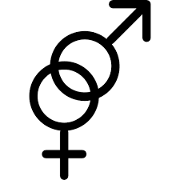
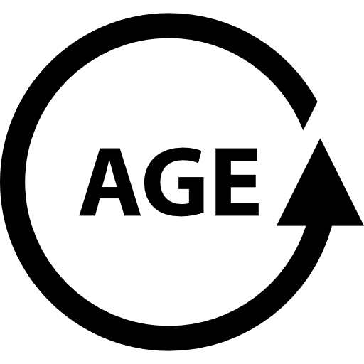

Compare family-posted profiles to self-posted profiles through matching
👴🏾
🧑🏽
🧑🏽
Identical
Caste
Group
Caste
Group
79% of family-posted profiles have a match

Slide 15
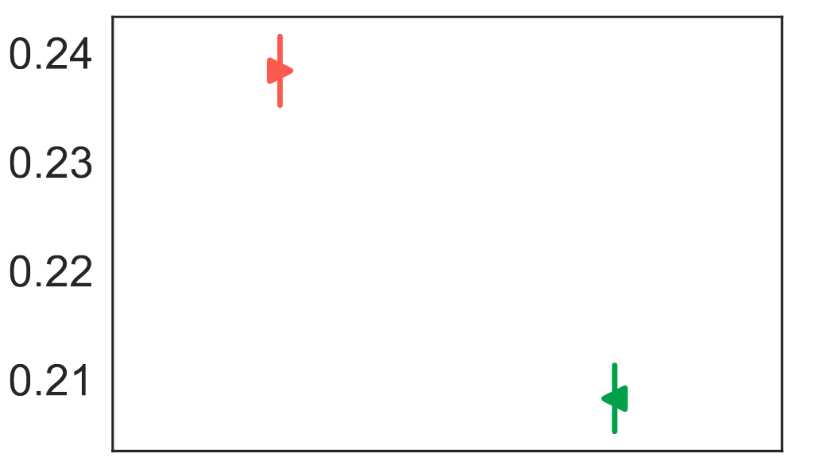
People who self post are more open than their counterparts whose family posts
Openness to
Intercaste marriage
Self-posted
Family-posted
RQ1a: What demographic factors might explain this difference?

Slide 16
Quantify the factors associated with openness using a mixed-effect model
Gender: Male, Female
Age: z-score of age
Is First Marriage: Yes, No
In a City over 1M people: Yes, No
Education: High school, College, Postgraduate
Parental Employment: Both, Father, Mother, Neither, Not Answered
Income: Above Median, Below Median, Not Answered
Affluence: Affluent, Upper Middle Class, Lower-middle or Middle Class, Not Answered
Caste: Brahmin, OFC, OBC, SC, ST, Intercaste, Other
Days profile has been on site: z-score
Random Effect for State
Reference category
Train separate models for self-posted and family-posted profiles

Slide 17
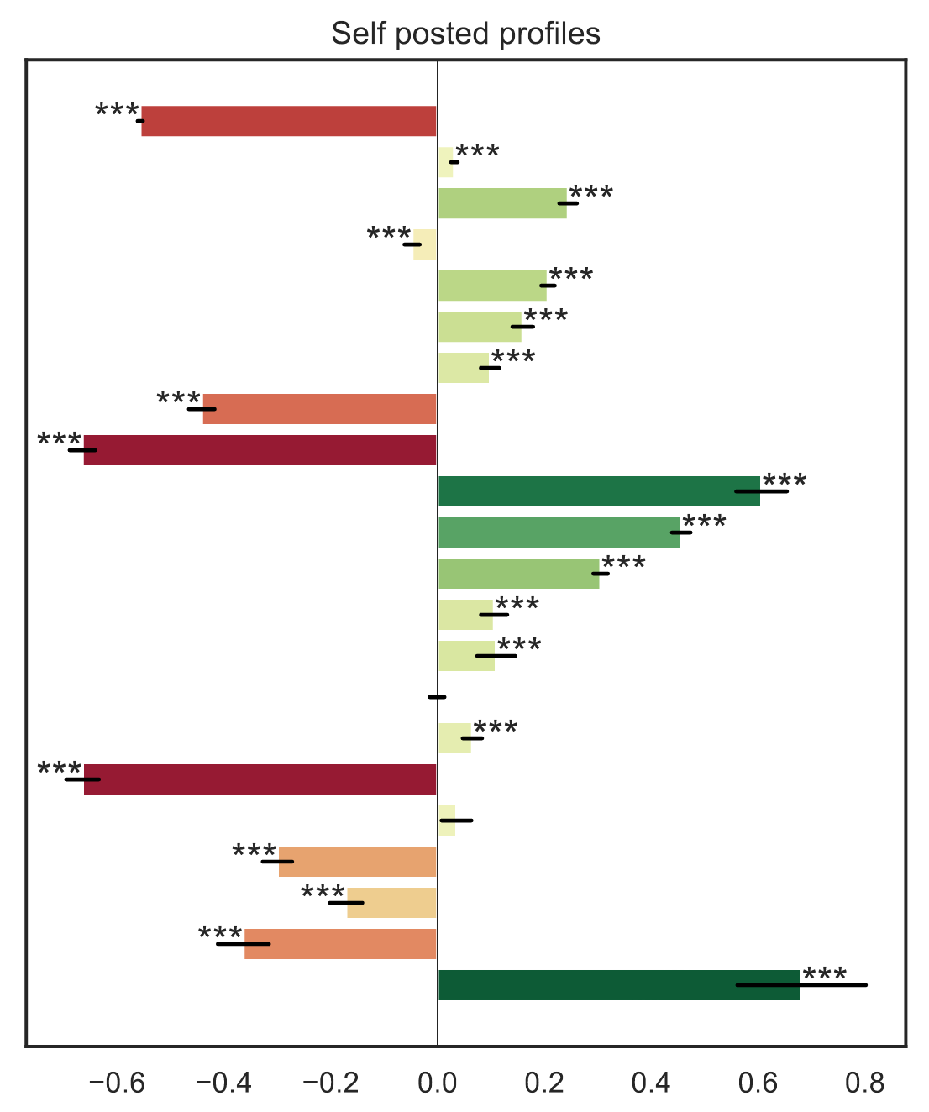
What factors are associated with openness in self-posted profiles?
Days on site age
Is Male
Is First Marriage In City > 1M people Post-grad degree College degree Above Median Income Below Median Income Affluent Upper Middle Class Lower Middle Class Both Parents Employed Only Mother Employed Only Father Employed
Not Answered Brahmin Other Forward Caste Other Backward Caste
Scheduled Caste
Scheduled Tribe Intercaste
Less
open
Log odds
More
open

Slide 18
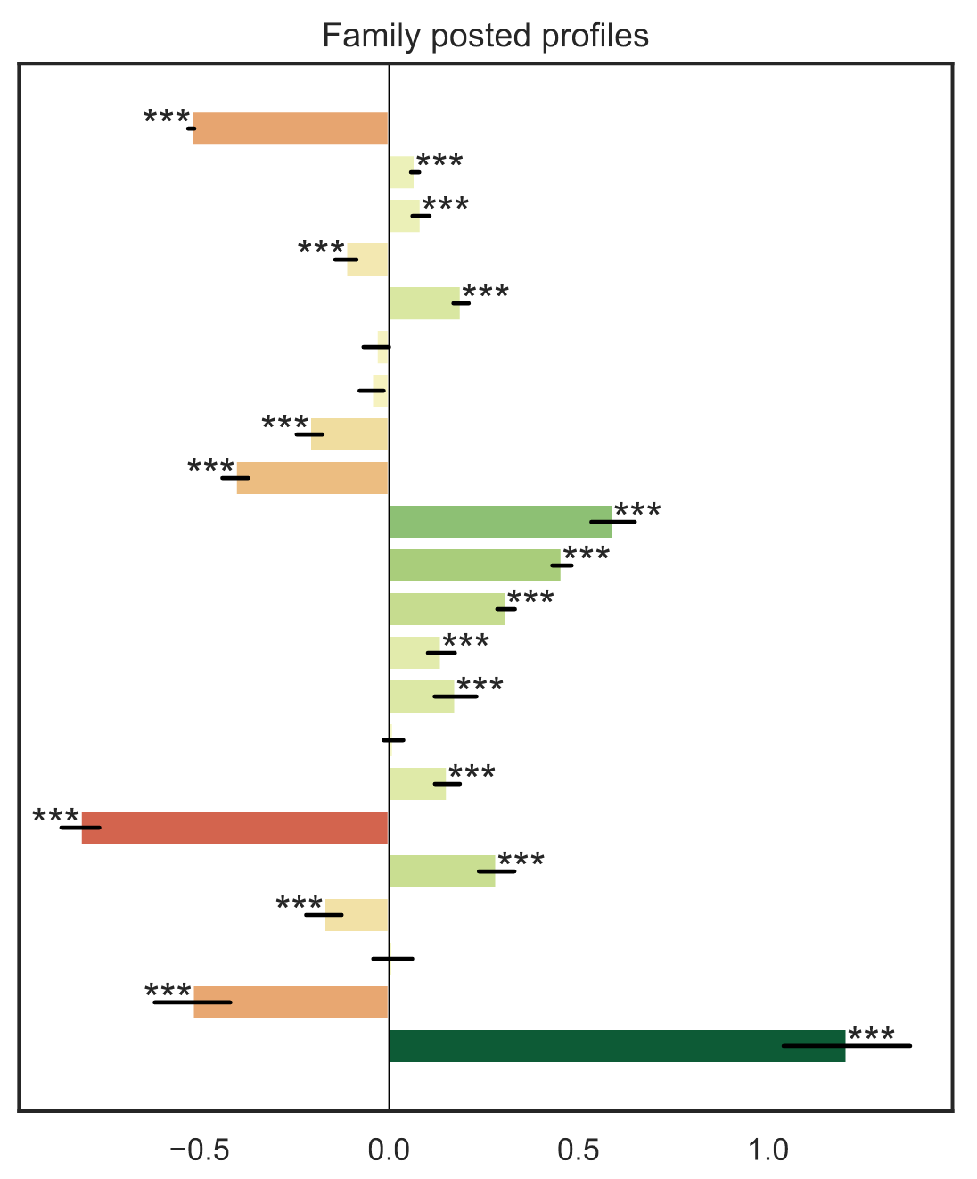
How do self-posted versus family-posted compare?
Days on site age
Is Male
Is First Marriage In City > 1M people Post-grad degree College degree Above Median Inc Below Median Inc Affluent Upper Middle Class Lower Middle Class Both Parents Empl Only Mother Empl Only Father Empl
Not Answered Brahmin Other Forward C Other Backward C
Scheduled Caste
Scheduled Tribe Intercaste
Less
open
Log odds
More
open
Less
open
Log odds
More
open
Notes:
age, male, large city - proxy urbanity

Slide 19
Research Questions
Are there differences in openness to intercaste marriage when individuals have more agency in choosing their spouse?
RQ2: If not caste, what attributes do individuals who are open to intercaste marriage prefer in a spouse?
Who has agency matters, education is positively correlated with openness only in self posted profiles.
kunjan detroja [CC BY-SA 2.0 (https://creativecommons.org/licenses/by-sa/2.0)]

Slide 20
Partner preference statements
Family, profession location | Looking for someone from a good family with a settled job in Delhi
caste, education | Seeking a suitable match of the same caste, ideally with a graduate degree
personality | Hoping for a like-minded partner who is warm, funny and supportive
self posted | Looking for someone from a good family with a settled job in Delhi
self posted | Seeking a suitable match of the same caste, ideally with a graduate degree
self posted | Hoping for a like-minded partner who is warm, funny and supportive
Extracted desiderata from partner preferences from self-posted profiles

Slide 21
Theory suggests mate-selection is driven by multiple attributes
Attributes | Example Desiderata | Reference
Family | parents, mom, families | Apostolou 2010
Caste | community, brahmin, iyer | Banerjee et al. 2009
Education | well-educated, degree, IIT | Prakash and Singh 2014
Age | years, young, younger | Dalmia 2004
Profession | profession, work, job | Prakash and Singh 2014
Finances | earnings, financially, career | Kamble et al. 2014
Physical Attrs. | slim, tall, fair | Dalmia 2004
Health | smoking, non-smoker, teetotaler | Kamble et al. 2014
Attractiveness | beautiful, handsome, pretty | Apostolou 2008
Personality | loyalty, honesty, funny | Perilloux et al. 2011
Location | USA, mumbai, relocate
Attributes | Example Desiderata | Reference
Family | parents, mom, families | Apostolou 2010
Caste | community, brahmin, iyer | Apostolou 2010
Education | well-educated, degree, IIT | Prakash and Singh 2014
Age | years, young, younger | Dalmia 2004
Profession | profession, work, job | Prakash and Singh 2014
Finances | earnings, financially, career | Kamble et al. 2014
Physical Attrs. | slim, tall, fair | Dalmia 2004
Health | smoking, non-smoker, teetotaler | Kamble et al. 2014
Attractiveness | beautiful, handsome, pretty | Apostolou 2008
Personality | loyalty, honesty, funny | Perilloux et al. 2011
Location | USA, mumbai, relocate

Slide 22
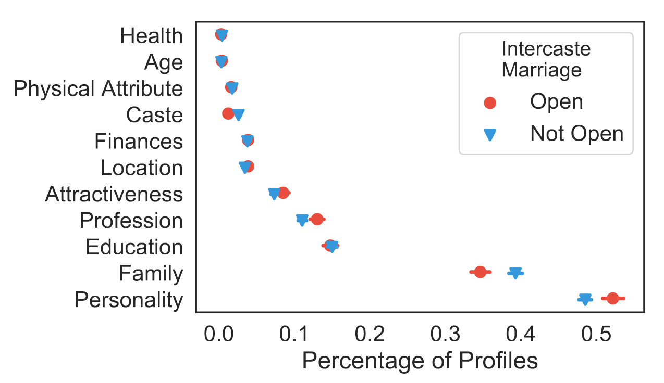
Does increased openness to intercaste marriage signal a shift in which attributes are desired in a spouse?
Open profiles contain more mentions of the partner’s personality and fewer mentions of their family
Percent of profiles mentioning that attribute

Slide 23
Research Questions
RQ1: Are there differences in openness to intercaste marriage when individuals choose their spouse, as opposed to their family?
RQ2: If not caste, what attributes do individuals who are open to intercaste marriage prefer in a spouse?
Who has agency matters, education is positively correlated with openness only in self posted profiles.
Open individuals look for individualistic personality attributes more than collectivist family-based aspects in prospective spouse.
kunjan detroja [CC BY-SA 2.0 (https://creativecommons.org/licenses/by-sa/2.0)]

Slide 24
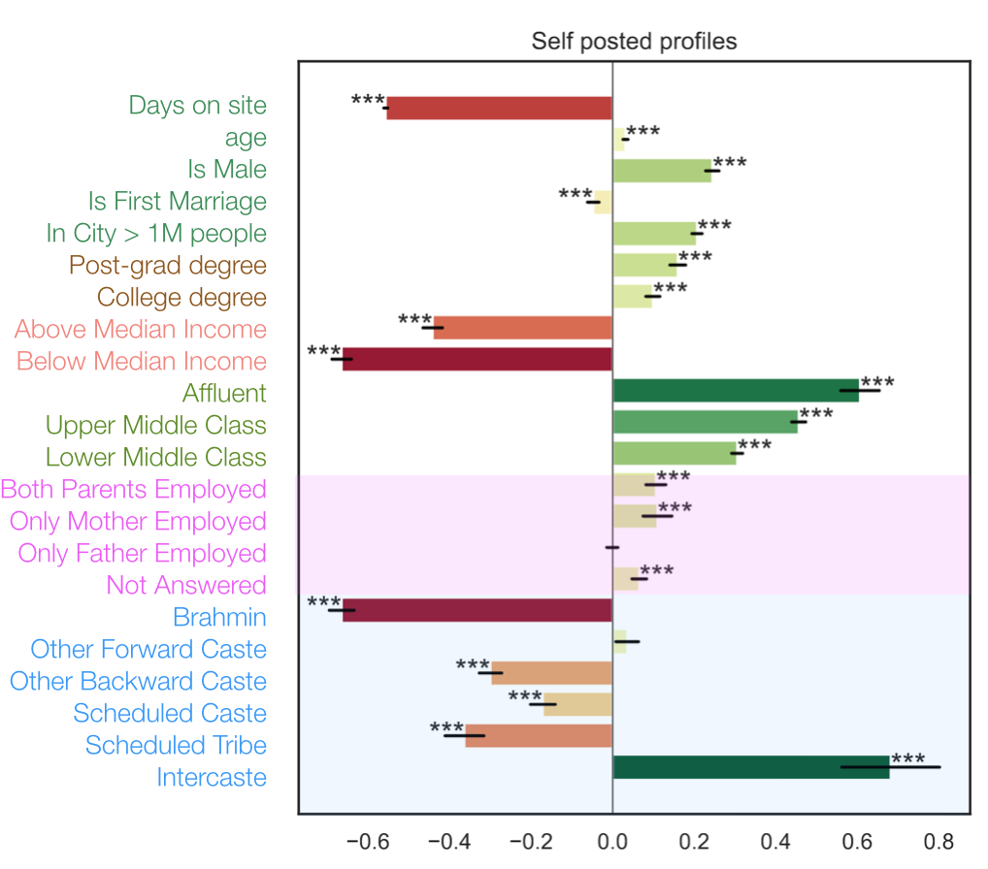
Summary
Openness to
Intercaste marriage
Self-posted
Family-posted
Collaborators
arajades@umich.edu
@R_Ashwin
Ram
Mahalingam
David
Jurgens

Slide 25
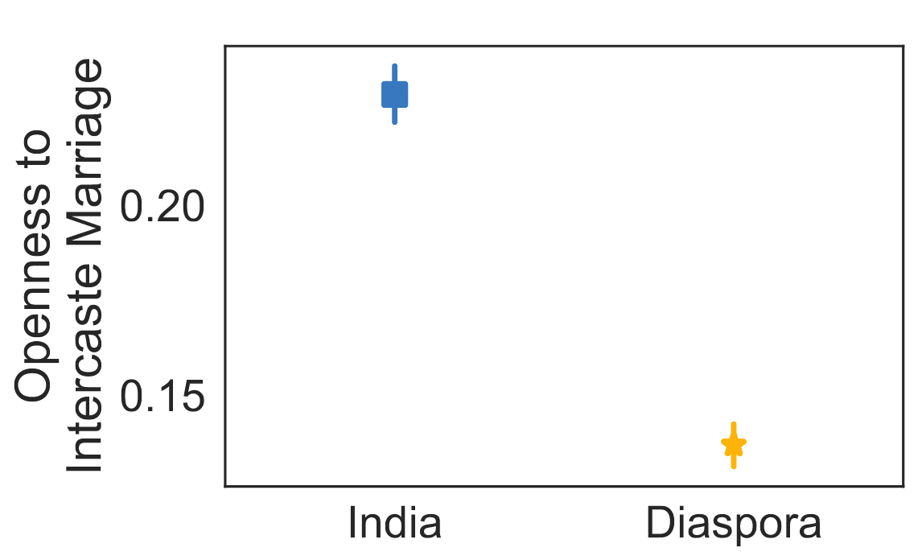
US-based diaspora are substantially less open than their Indian counterparts
in US
Notes:
We find that US based Diaspora are significantly less open than their Indian counterparts.

Slide 26
Caste system
Kshatriyas
kings, warriors
Vaishyas
merchants
Brahmins
priests
Shudras
peasants, domestic workers
Forward/Upper castes
Other Backward
Castes (OBC)
Adivasis
Dalits
Scheduled
Tribes
(ST)
Indigenous people,
Stripped of land, natural resources
Slave and bonded labor,
undignified sanitation work
Scheduled Castes
(SC)
Source: Report on Caste in the United States, Equality Labs

